Slide 1
Frequently Asked Questions
On the following slides, we answer some frequently asked questions (FAQs) about Family Dispute Resolution (FDR) at our Family Relationship Centres (FRCs).
Updated 30 April 2024

Slide 2
Relationships Australia Victoria acknowledges First Nations peoples as the Traditional Owners and Custodians of the lands and waterways of Australia. We support their right to self-determination and culturally safe services.
We pay our respects to Elders past and present, and recognise and value the ongoing contributions of Aboriginal and Torres Strait Islander peoples which enrich all communities within Victoria.
We are committed to providing safe, inclusive and accessible services for all people.

Slide 3
Question 1: What is FDR?
FDR stands for Family Dispute Resolution. This name was introduced in 2007 when the Family Law Act was amended.
FDR is different from other services and processes, such as counselling and court-based mediation.
FDR is often called mediation.
FDR uses step-by-step process to help people involved to negotiate and reach an agreement on the care of their children and/or financial or property settlements.

Slide 4
Question 2: What is an FDRP?
Family Dispute Resolution Practitioners (FDRPs) are the mediators who provide FDR.
FDRPs have specialised training and are registered as accredited practitioners with the Australian Government Attorney-General’s Department.
Our practitioners are very experienced and skilled in providing a safe, structured and professional process to facilitate communication and decision-making.

Slide 5
Question 3: When is FDR required?
FDR can help separating or divorcing couples to resolve disputes and reach agreements about parenting and/or property matters.
Australian family law requires parents to attempt FDR before they can file an application for parenting orders. There are some exceptions to this requirement, however.

Slide 6
Question 4: Why try FDR?
Reaching an agreement through FDR can give you a greater sense of agency and control, and lead to a more satisfactory agreement for everyone including your children.
When it is safe and appropriate, FDR is an affordable alternative to formal legal processes.
Research shows that FDR can improve communication, reduce conflict and strengthen co-parenting skills.

Slide 7
Testimonial
“FDR really reaffirmed for both of us what’s in the best interest of our boys... We were reminded to continually focus on that and that’s actually been a really cool thing.
I can actually communicate with the boys’ mother if it’s about the children. I can do it with ease, like, and friendly and respectfully.
I can’t speak to her about other things, but through mediation we were reminded a bit you’re just focusing on the interests of the children. It’s really cool to be able to talk with her about that.”
- Dad, 41

Slide 8
Question 5: What is the process for FDR?
The process involved in FDR is explained in depth throughout this presentation, however the next 5 slides provide a quick summary of this process.

Slide 9
Step 1: Call
Step 1: Call
STEP 2:
Assessment appointment
STEP 3:
Information session
STEP 4:
Second parent
STEP 5:
Mediation
Contact the Family Relationship Centre.
Answer a series of basic questions to help our staff understand your circumstances.
Book an assessment appointment to meet with a practitioner.

Slide 10
Step 2: Assessment appointment
Step 1:
Call
STEP 2:
Assessment appointment
STEP 3:
Information session
STEP 4:
Second parent
STEP 5:
MEDIATION
Meet separately (one-on-one) with an FDRP.
Discuss the essential details about you, your children (if applicable), and your situation.
The FDR process will be explained, and appropriate referrals and necessary information will be provided to you.

Slide 11
Step 3: Information session
Step 1:
Call
STEP 2:
Assessment appointment
STEP 3:
Information session
STEP 4:
Second parent
STEP 5:
MEDIATION
May be held before or after your assessment meeting, either in-person or online, depending on the centre and the current circumstances.
Provides information on parenting after separation and an opportunity to reflect on the children’s experiences when their parents minimise conflict and focus on their interests.
Suggests how to prepare for mediation and how mediation fits in the family law system.

Slide 12
Step 4: Second parent
Step 1:
Call
STEP 2:
Assessment appointment
STEP 3:
Information session
STEP 4:
Second parent
STEP 5:
Mediation
The steps so far are repeated for the other person/party.
Suitability for FDR is determined by the FDRP after meeting both parties. The FDRP will discuss this with you.
Confidentiality is maintained throughout the process.

Slide 13
Step 5: Mediation
Step 1:
Call
STEP 2:
Assessment appointment
STEP 3:
Information session
STEP 4:
Second parent
STEP 5:
Mediation
FDR can occur in the same room, in separate rooms, or by telephone or by video.
Your FDRP will ensure a safe, respectful, structured, professional process to support decision making.
An agenda is agreed upon by both participants, ideas are proposed and discussed, and agreements can be made.

Slide 14
Question 6: What happens in an FDR assessment?
Once someone calls us and asks for FDR, they are offered an individual assessment appointment.
This assessment helps the FDRP to understand the person’s situation, determine if the service is appropriate for them and their circumstances, and work through the next steps for both parties (people in dispute) participating in FDR.

Slide 15
Question 6: What happens in an FDR assessment?
They’re also offered relevant information and referrals to a range of services, and are invited to attend an information session.

Slide 16
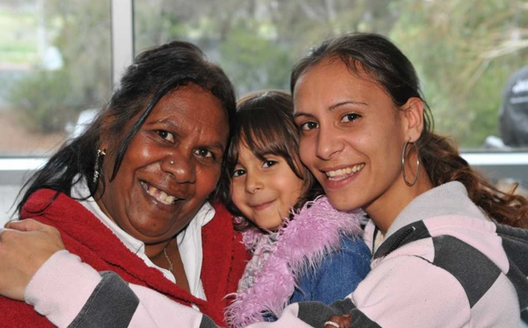
Question 7: What type of families do your FRCs help?
FDR can be used by all families, including:
Families where the parents are separated
Extended families; Parents and grandparents
Aboriginal and Torres Strait Islander families
Families from LGBTIQA+ communities
Others with significant relationships with the children
Families from culturally and linguistically diverse backgrounds

Slide 17
Question 8: What about safety?
The safety of our clients, your families, and our staff, is our number one priority. We are committed to:
safety for clients when attending our centres or using our services remotely (e.g. telephone or video appointments)
a thorough assessment and an ongoing focus on the safety and welfare of clients when participating in FDR
the safety and best interests of children. This is a primary consideration in the FDR process.

Slide 18
Question 9: If FDR is appropriate for a family, what happens during an FDR session?
If after an assessment, an FDRP determines that FDR may be a helpful process for a family’s current situation:
an appointment is booked for both parties to attend FDR
the parties may be present in the same room, or they may be in separate rooms (a process called shuttle FDR). The FDRP decides this.

Slide 19
Question 9: If FDR is appropriate for a family, what happens during an FDR session?
During FDR:
the FDRP will help to identify what is in dispute (an agenda)
with the help of the FDRP, the parties will consider and discuss options that are in the best interests of the children. In property FDR parties go through a process to help achieve a property settlement.
after a period of negotiation, the FDRP may ask to talk to both parties separately to check in or explore ideas. Clients may also ask for this.
finally, the FDRP will assist parties to make a Parenting Plan or other agreement about their children. For property matters, a property agreement or other options may be explored. In some cases, the FDR process may take more than one appointment.

Slide 20
Question 10: What about family violence and FDR?
We take family violence very seriously:
During the individual assessment that all clients attend, the FDRP screens for and explores any safety issues, and works through next steps.
People who are impacted by family violence are provided relevant information and referrals.
We know that FDR can still be helpful for some families impacted by family violence, and will only proceed where it is assessed as safe to do so.

Slide 21
Question 11: Am I going be to forced into an agreement?
Clients will NOT be forced into making an agreement.
One of the conditions of a Parenting Plan or any other parenting or property agreement is that it must be made voluntarily and without threat, duress and coercion.
The purpose of FDR is to provide a safe process where clients can explore issues, consider their options and choose whether or not to make decisions and agreements.

Slide 22
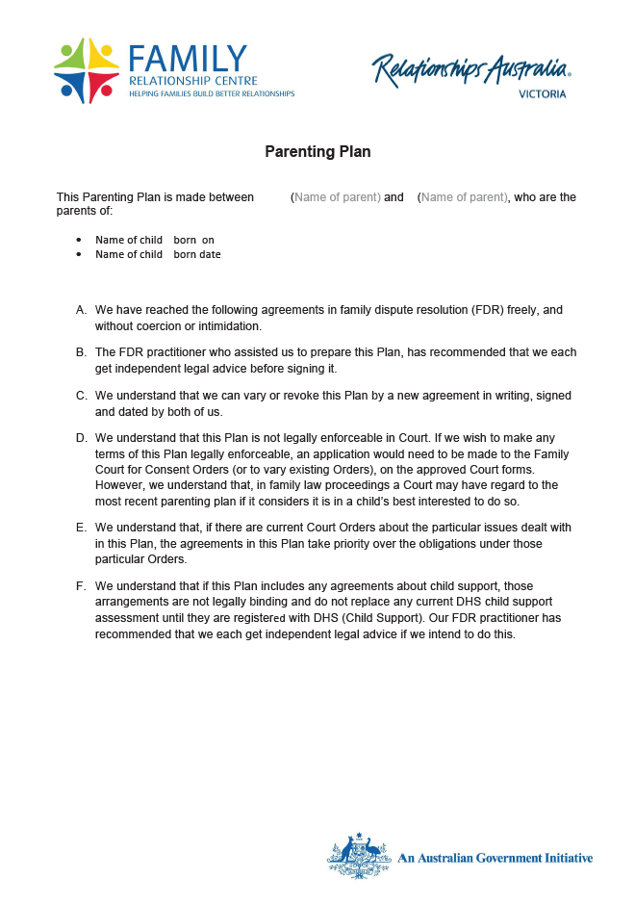
Question 12: What is a Parenting Plan?
A Parenting Plan:
is a list of agreements, made between parents, about spending time with and caring for children. Other people with an interest in children’s lives, such as grandparents, can also make written agreements in FDR.
is made voluntarily without threat, duress or coercion
if signed, will be considered by the court should parents end up in court at a later stage, however a Parenting Plan is not legally binding.

Slide 23
Question 13: How are the interests of children represented?
The interests of children are represented by:
FDRPs providing relevant information about, and referrals to meet, the needs of children
FDRPs keeping a focus on children throughout the FDR process. Parents are encouraged to make decisions in their children’s best interests.

Slide 24
Question 13: How are the interests of children represented?
The interests of children are also represented by:
parents being encouraged to attend the ‘Focus on Kids’ session that focuses on the needs of the children. Participants attend via webinar and are not visible to other participants.
using an optional process known as Child-Inclusive Practice, where the children are interviewed. This process is available when both parents agree and the FDRP thinks it is suitable.

Slide 25
Question 14: How can I best prepare for FDR?
You can prepare for FDR by:
considering your priorities
For example, what are the crucial, relatively important and less important issues?
thinking through both your best-case scenario, and what you would be willing to accept as an outcome
coming to FDR with an open mind and willingness to explore options that don’t compromise safety.

Slide 26
Question 15: What happens if an FDRP decides that FDR isn’t suitable for our situation?
FDRPs are required to assess whether FDR is suitable for each case, based on a range of different factors outlined in the FDRP Regulations (2008): https://www.legislation.gov.au/Details/F2008L03470
FDRPs make these decisions carefully, often in consultation with supervisors and/or managers.
If FDR is not appropriate, the FDRP will explore other options with clients such as negotiation through lawyers and legal processes.

Slide 27
Question 16: How much does it cost?
We are only partly government funded so some fees are charged for FDR services.
We try to make our services as affordable as possible and will discuss this with you when you contact us to make an appointment.

Slide 28
Question 17: How does FDR consider children’s different stages of development?
How do I support my children in an age-appropriate way?
For children aged 5 and under, we encourage you to:
provide lots of reassurance to your children and not just when they look distressed
be patient if your children have disrupted sleep and are unsettled
consider that any changes to their routine need to be brought in slowly and sensitively
avoid talking negatively about the other parent in front of your children.

Slide 29
Question 17: How does FDR consider children’s different stages of development?
For children aged 5 to 8:
reassure them that they don’t have to choose between you and the other parent
provide an opportunity for your children to talk about the anger and loneliness they may feel
provide sensitive and age-appropriate answers to questions or statements; this age group often longs for their parents to get back together
avoid talking negatively about the other parent or burdening your children with adult issues.

Slide 30
Question 17: How does FDR consider children’s different stages of development?
For children aged 8-12:
give them an opportunity to talk about what’s happening for them without asking them to choose between parents
keep in mind how any time arrangements impact on their sporting and social activities
make it clear that you’re the adult and they don’t have to carry any adult responsibilities
provide comfort and time to talk about their fears and concerns
avoid talking negatively about the other parent.
CHILD/REN OF RELEVANT AGE

Slide 31
Question 17: How does FDR consider children’s different stages of development?
For adolescents:
be prepared to listen and talk with them
find a confidant to talk to about your adult issues and keep your fears, anxieties and financial stresses away from your teenagers
give them time and space to work through their own reactions to the separation
don’t talk negatively about the other parent.

Slide 32
Question 18: What is property FDR?
Property FDR enables separated people to address and negotiate a property and financial settlement.
The process involves:
parties agreeing on a list of assets and debts and their value
discussions about contributions and future needs
presentation of options
discussion and negotiation
finalising agreements (if made).

Slide 33
Question 18: What is property FDR?
To learn more, read Relationships Australia’s booklet:
A fair share: Negotiating your property settlement
http://bit.ly/RAVfairshare

Slide 34
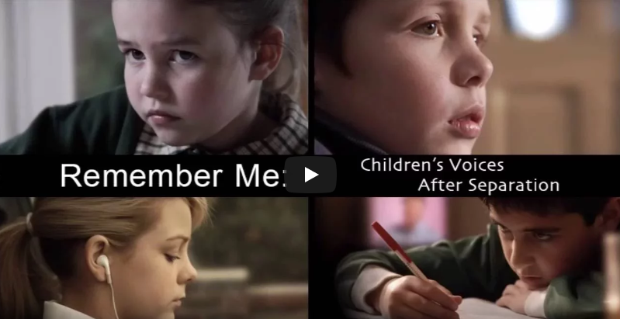
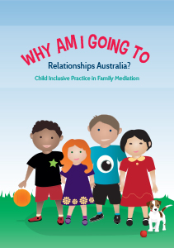
Question 19 – What are some useful resources for me?
Child-Inclusive Practice resources
Video resources that make us reflect on what children may be experiencing
What about the children? A booklet by Relationships Australia
http://bit.ly/RAVchildren
One example is: ‘Remember Me’ which shares 4 different stories of children during separation: www.youtube.com/watch?v=YPUnmt95N28
Why am I going to Relationships Australia? An illustrated children’s booklet by Relationships Australia
https://bit.ly/WhyGoingRA
Used with permission from the Australian Government Attorney-General's Department.

Slide 35
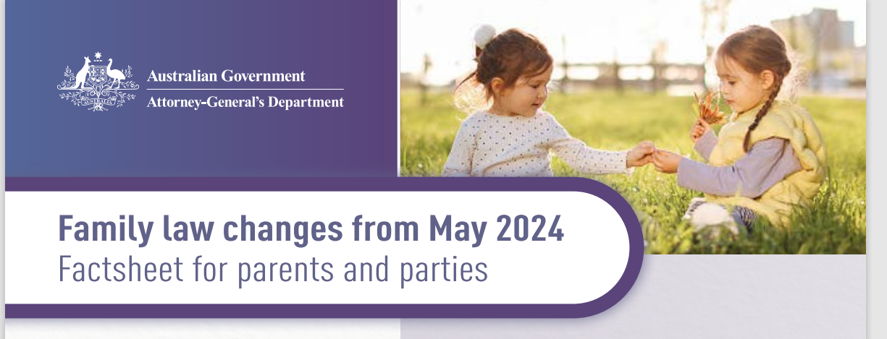
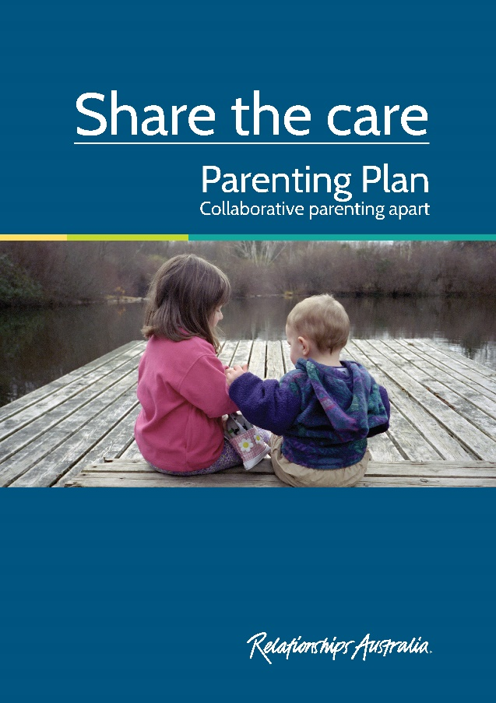
Question 19 – What are some useful resources for me?
Parenting Plan resources
Family law changes from May 2024 Australian Government fact sheet for parents and parties.
https://www.ag.gov.au/sites/default/files/2024-01/family-law-amendment-act-2023-factsheet-for-family-law-parents.PDF
Share the care - Parenting Plan: Collaborative parenting apart A booklet by Relationships Australia
http://bit.ly/RAVsharethecare

Slide 36
Question 19 – What are some useful resources for me?
Family violence resources
For immediate safety concerns, call 000.
For 24/7 information and advice where you are not in immediate danger, contact Safe Steps Family Violence Response Centre (Victoria): https://www.safesteps.org.au
For 24/7 confidential counselling and support for family violence and/or sexual assault, contact 1800RESPECT: https://www.1800respect.org.au
LGBTIQA+ Victorians can contact Rainbow Door, a specialist LGBTIQA+ helpline providing information, support, and referral. www.rainbowdoor.org.au/family-violence
Aboriginal and Torres Strait Islander women can contact Djirra: https://djirra.org.au
Women from culturally and linguistically diverse backgrounds can contact inTouch: https://intouch.org.au
For more resources, visit www.rav.org.au/resources/services-for-people-affected-by-violence-abuse-and-trauma

Slide 37
Question 19 – What are some useful resources for me?
Mental health resources
Lifeline Australia: 24/7 crisis support and suicide prevention services. Phone 13 11 14 or visit http://www.lifeline.org.au
SuicideLine Victoria: 24/7 telephone, video and online counselling. Phone 1300 651 251 or visit https://suicideline.org.au
Suicide Call Back Service: 24/7 Australia-wide telephone and online counselling for people affected by suicide. Phone 1300 659 467 or visit https://www.suicidecallbackservice.org.au
Kids Helpline: 24/7 telephone and online counselling service for young people aged 5-25. Phone 1800 55 1800 or visit www.kidshelp.com.au
MensLine Australia - 24/7 telephone and online counselling for men. Phone 1800 737 732 or visit https://www.mensline.org.au
For more resources, visit www.rav.org.au/resources/mental-health-services

Slide 38
Question 19 – What are some useful resources for me?
General parenting resources
Parentline – A phone counselling support service for parents and carers of children aged 0-18 years, providing advice on parenting after separation, disagreement about parenting strategies between care givers, child behaviour and development, child/parent conflict, family violence, bullying and parental stress. Phone 1300 301 300 or visit https://parentline.com.au
Family Relationship Advice Line – A national telephone service that assists families affected by relationship or marriage breakdown. Phone 1800 050 321 or visit www.familyrelationships.gov.au
Raising Children Network – Online resources for parents. http://www.raisingchildren.net.au
For more resources, visit www.rav.org.au/resources/family-parenting-services

Slide 39
Question 19 – What are some useful resources for me?
Resources for women
Women and separation: Navigating new horizons
A booklet by Relationships Australia.
http://bit.ly/RAVwomensep

Slide 40
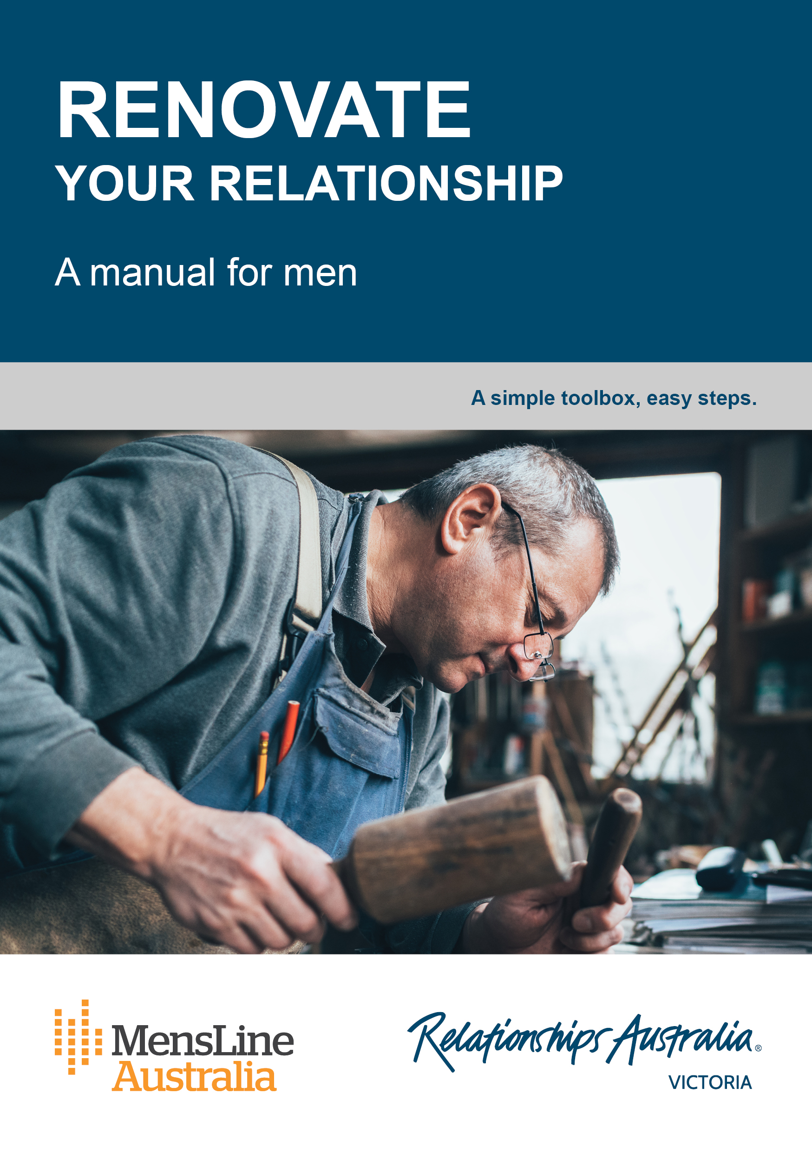
Question 19 – What are some useful resources for me?
Resources for men
Booklets by Relationships Australia
Men and separation http://bit.ly/RAVmensep
Renovate your relationship https://bit.ly/RAV-RYR
On being a dad https://bit.ly/RAVBeingDad

Slide 41
Question 19 – What are some useful resources for me?
Resources for LGBTIQA+ community members
General advice and support can be found at Switchboard www.switchboard.org.au
Counselling and mental health support can be found at https://www.queerspace.org.au/ and www.thorneharbour.org/
Q-Life provides anonymous and free LGBTIQ+ peer support and referral for people in Australia wanting to talk about sexuality, gender, bodies, feelings or relationships. Visit https://qlife.org.au
For more resources, visit www.rav.org.au/resources/lgbtiqa-support-services

Slide 42
Question 19 – What are some useful resources for me?
Legal support and advice
The Legal Aid Helpline: https://www.legalaid.vic.gov.au
Community Legal Centres (eligibility criteria may apply): https://www.fclc.org.au
The Law Institute of Victoria (for private legal assistance): https://www.liv.asn.au/find-a-lawyer
Victorian Aboriginal Legal Service (Referrals, advice/information, duty work or case work assistance): https://www.vals.org.au
For more resources, visit www.rav.org.au/resources/government-legal-services

Slide 43
Question 19 – What are some useful resources for me?
Support for First Nations peoples
The Healing Foundation supports Stolen Generations survivors, families and communities. https://healingfoundation.org.au
Rumbalara Aboriginal Co-operative Ltd offers whole-of-life care designed around the needs of the community. https://rumbalara.org.au
For support related to family violence and homelessness, contact the Aboriginal Centre for Males Referral Service http://www.vacsal.org.au/programs/aboriginal-centre-for-males-referral-service.aspx
For a comprehensive list of services for Aboriginal and Torres Strait Islander people, visit the Victorian Aboriginal Health Service website: https://www.vahs.org.au
For more resources, visit www.rav.org.au/resources/aboriginal-community-controlled-organisations

Slide 44
Question 19 – What are some useful resources for me?
Resources for culturally and linguistically diverse people
For resources for asylum seekers, visit https://www.asrc.org.au
Migrant Resource Centres are available in various locations across Melbourne.
Victorian Refugee Health Network: http://refugeehealthnetwork.org.au
Foundation House, whose mission is to help refugees rebuild their lives https://foundationhouse.org.au
For more resources, visit www.rav.org.au/resources/multicultural-services

Slide 45
Question 19 – What are some useful resources for me?
Parenting programs at Relationships Australia Victoria
Relationships Australia Victoria runs a Parenting After Separation Seminar program: www.rav.org.au/pass
We also deliver Tuning in to Kids® and Tuning in to Teens™ programs which help parents to understand, communicate and connect with their children.
Visit www.rav.org.au/child-parenting-courses to view our upcoming child and parenting courses.

Slide 46
Further questions?
Thank you for taking the time to look at this presentation.
If you have any further questions, please talk to your
Family Dispute Resolution Practitioner.

